Slide 1
Data Structures
and
Algorithms
CSCI 237 –
Fall 2019

Slide 2
Algorithmic Problem Solving
In designing an Algorithm:
Understand the problem
Understand the inputs
Understand the outputs
Organize the inputs
Develop the algorithm to convert inputs to outputs
What is a Correct Algorithm?
One that works correctly for all legitimate inputs
What about an algorithm that works most of the time? Is this Correct?

Slide 3
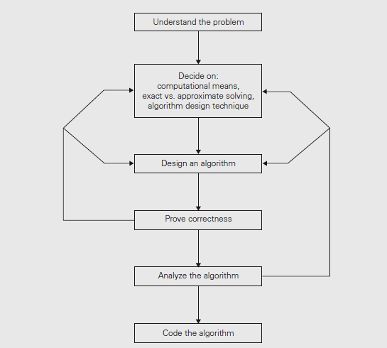
Algorithm Design

Slide 4
Algorithm Design Considerations
Other Algorithm Design Considerations:
Sequential or parallel execution
Exact versus Approximation
Are all problems solvable exactly?
Device capacity and capability: RAM, CPU Speed

Slide 5
Algorithm Design Technique
Algorithm Design Technique:
A general approach to solving problems, algorithmically, that is applicable to a variety of problems from different areas of computing.
Tried and tested algorithm design techniques:
Divide and Conquer
Recursive/Dynamic Programming
Greedy
Back-tracking
What about brute force algorithm?

Slide 6
Algorithm Design
Correctness of Algorithm: How to prove?
Induction
Contradiction
Direct proof
Characteristics:
Efficiency
Space Efficiency
Time Efficiency
Simplicity
Generality

Slide 7
Algorithm Design
Algorithm Versus Implementation
What is the difference between the two?
How does one know when to stop refining an algorithm?
Can an Algorithm be developed to solve every problem?
For solvable problems will optimal solution, always, result?

Slide 8
Problem Types
Counting
Sorting
Searching
String Processing
Graph problems
Combinatorial problems
Geometric problems
Numerical problems
Partition problems

Slide 9
Counting Problem
Counting
An experiment consists of rolling a 20 sided die three times. The number on top of each die is recorded. The numbers are written down in the order in which they are observed. How many possible ordered triples of numbers can result from the experiment?
(Note the triple (17, 10, 3) is not the same result as the triple (3, 10, 17). )

Slide 10
Counting Problem
Counting
Powerball Lottery:
When you buy a Powerball ticket, you select 5 different white numbers from among the numbers 1 through 59 (order of selection does not matter), and one red number from among the numbers 1 through 35.
How many different Powerball tickets can you buy?

Slide 11
Counting Problem
Counting Powerball Lottery:
Let us understand the problem using the following simplified example.
Numbers 1-6, from which 3 number fill the white spaces, and the red number is selected from the set {1,2,…,10}.
Remember: For example the white space sequence 3 6 5 is the same as sequences 6 5 3, 6 3 5, 5 6 3, 5 3 6, 3 5 6 since the sequences are created from the same combination of numbers, namely {3,5,6}.
Note: When your problem involves picking m items from a set of n items, and the order of items in selection set is immaterial, we can use combination principle to count the different selections possible.

Slide 12
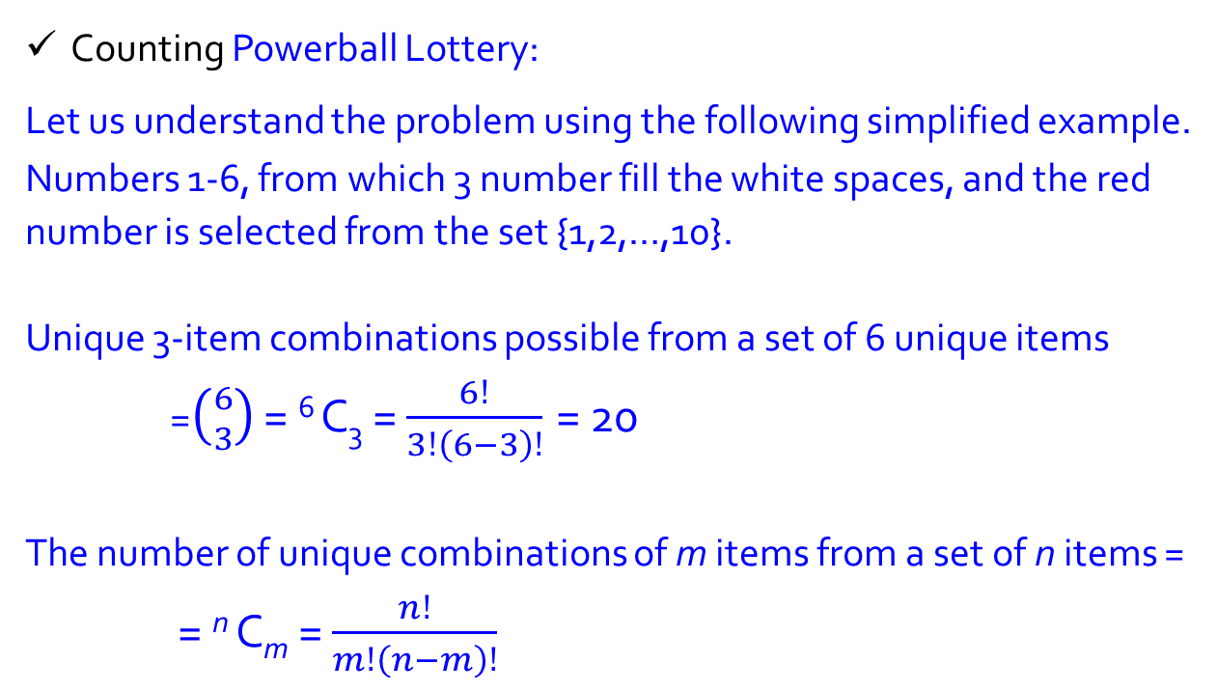
Counting Problem
Counting Powerball Lottery:
Let us understand the problem using the following simplified example.
Numbers 1-6, from which 3 number fill the white spaces, and the red number is selected from the set {1,2,…,10}.
Unique 3-item combinations possible from a set of 6 unique items
=$\left({6 \atop 3}\right)$ = ⁶ C₃ = $\frac{6!}{3!\left(6−3\right)!}$ = 20
The number of unique combinations of m items from a set of n items =
= ^{n} C_{m} = $\frac{n!}{m!\left(n−m\right)!}$

Slide 13
Counting Problem
In the Lottery problems you need to select 5 distinct white numbers,
so you can do this C(59, 5)= ^{n} C_{m} = 5, 006, 386 ways.
Then you can pick the one red number
so you can do this C(35, 1) = 35 ways
So the total number of tickets is
C(59, 5) · P(35, 1) = 5, 006, 386 · 35 = 175, 223, 510.

Slide 14
Counting Problem
Counting Powerball Lottery:
Consider the Scenario: What If order of selection matters!
For example this means
1 2 3 is different from 1 3 2 is different from 2 1 3 is different from
2 3 1 is different from 3 1 2 is different from 3 2 1

Slide 15
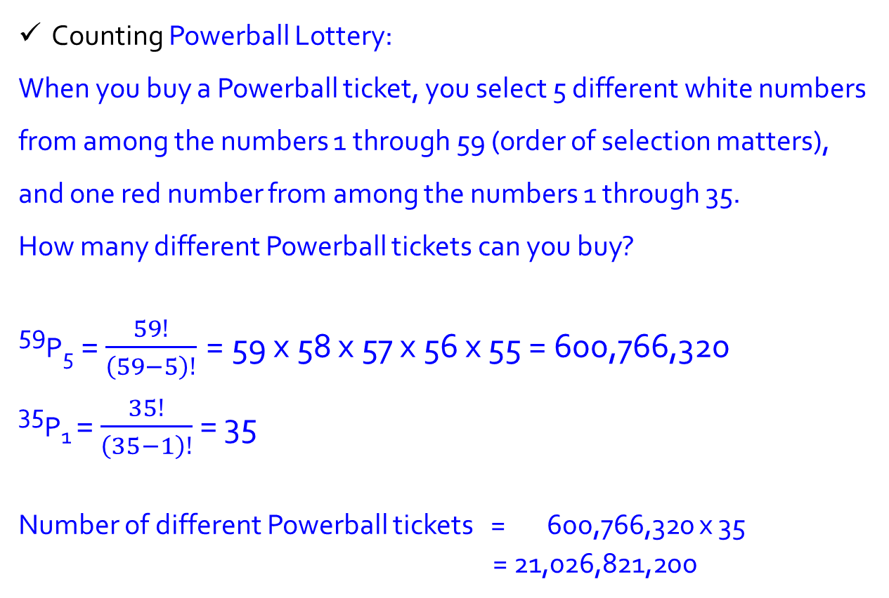
Counting Problem
Counting Powerball Lottery:
When you buy a Powerball ticket, you select 5 different white numbers from among the numbers 1 through 59 (order of selection matters), and one red number from among the numbers 1 through 35.
How many different Powerball tickets can you buy?
⁵⁹P₅ = $\frac{59!}{\left(59−5\right)!}$ = 59 x 58 x 57 x 56 x 55 = 600,766,320
³⁵P₁ = $\frac{35!}{\left(35−1\right)!}$ = 35
Number of different Powerball tickets = 600,766,320 x 35 = 21,026,821,200

Slide 16
Problem Types
Sorting
Sort in ascending or descending order a list (or sequence) of numbers, inputs etc.
Inputs are of uniform type.

Slide 17
Sorting Problem
To rearrange the items of a given list in nondecreasing order
What is that we want to sort?
Lists of numbers,
characters from an alphabet,
character strings,
records similar to those maintained by schools about their students, libraries about their holdings,
companies about their employees…
Why do we need to sort?
What information is needed to perform the sort?
In the case of records, we need to choose a piece of information to guide sorting – called KEY.

Slide 18
Sorting Problem
Two notable properties of sorting algorithms:
Stable algorithm:
If it preserves the relative order of any two equal elements in
its input.
In-place:
If algorithm does not require extra memory, except, possibly, for a few memory units.
There are important sorting algorithms that are in-place and those that are not.

Slide 19
Problem Types
Searching
Search a list (or sequence) for a given key

Slide 20
Searching problem
The searching problem deals with finding a given value, called a search key, in a given set or a multiset, which permits several elements to have the same value.

Slide 21
Searching problem
The algorithm is easily explained in terms of searching a dictionary for a word.
In a dictionary, words are sorted alphabetically. For simplicity, let us assume there is only one page for all words starting with each letter. Let us assume we wish to search for a word starting with some particular letter.

Slide 22
Searching problem
We open the dictionary at some midway page, let us say a page on which words start with M.
If the value of our letter is M, then we have found what we are looking for and the word is on the current page.
If the value of our letter is less than M, we know that the word would be found in the first half of the book, i.e. we should search for the word in the pages preceding the current page.
If the value of our letter is greater than M, we should search the pages following the current page.
In either case, the effective size of the dictionary to be searched is reduced to about half the original size.

Slide 23
Searching problem
We repeat the process in the appropriate half, opening to somewhere in the middle of that and checking again.
As the process is repeated, the effective size of the dictionary to be searched reduces by about half at each step until the word is found on a current page.
Binary search essentially follows this approach

Slide 24
Problem Types
String Processing
You are given a string S.
You need to check whether it's a palindrome or not.
OutputPrint "YES" (without quotes) if S is a palindrome and "NO" (without quotes) if S is not a palindrome.
To know what a palindrome is you can check http://bit.ly/HashesPallindrome

Slide 25
Problem Types
Palindrome:
Madam
Level
Mom
Noon
Racecar
Radar
Redder
Refer
Repaper
Rotator
My gym
Red rum, sir, is murder
Step on no pets
Top spot
Was it a cat I saw?
Eva, can I see bees in a cave?

Slide 26
Problem Types
Partition
Example:
Partition problem is to determine whether a given set can be partitioned into two subsets such that the sum of elements in both subsets is same.
arr[] = {1, 5, 11, 5}

Slide 27
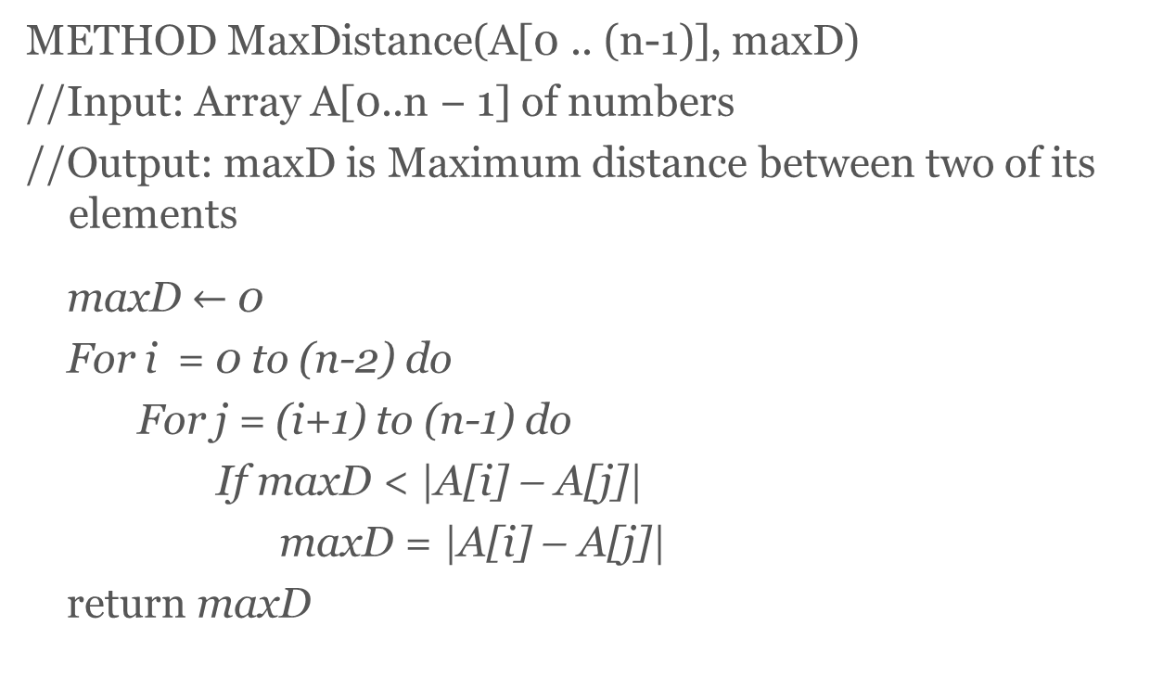
Quiz question
METHOD MaxDistance(A[0 .. (n-1)], maxD)
//Input: Array A[0..n − 1] of numbers
//Output: maxD is Maximum distance between two of its elements
maxD $←$ 0
For i = 0 to (n-2) do
For j = (i+1) to (n-1) do
If maxD < |A[i] – A[j]|
maxD = |A[i] – A[j]|
return maxD

Slide 28
Quiz question
Number of pairwise distances computed =
Number of comparisons =

Slide 29
DATA STRUCTURES
What is?
particular scheme of organizing related data items
- dictated by the problem at hand
Elementary data types: alpha or numeric
Standard Primitive Types
INTEGER,
REAL,
BOOLEAN,
CHAR,

Slide 30
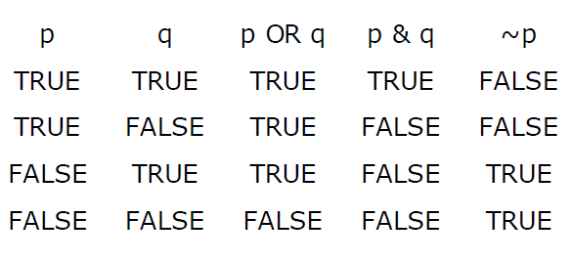
Boolean

Slide 31
DATA STRUCTURES
Data Structures - LISTS
(1) The most important concept related to lists is that of position.
(2) We perceive that there is a first element in the list, a second element, and so on.
(3) View a list as embodying the mathematical concepts of a sequence.
(4) List is a finite, ordered sequence of data items known as elements.
(5) “Ordered” in this definition means that each element has a position in the list. (Do not mix it up with “sorted by value”.)
(6) In simple list implementations all elements of the list have the same data type.

Slide 32
DATA STRUCTURES
Data Structures - LISTS
(7) list is said to be empty when it contains no elements.
(8) The number of elements stored is called the length of the list.
(9) The beginning of the list is called the head, the end of the list is called the tail.
(10) Sorted lists have their elements positioned in ascending order of value, while unsorted lists have no particular relationship between element values and positions.
(11) Two standard approaches to implementing lists, the array-based list, and the linked list.
(12) The linked list uses dynamic memory allocation, that is, it allocates memory for new list elements as needed.

Slide 33

Lists Implementation:
Array:
- Allows both direct and sequential access.
- Is a consecutive segment of memory that occupies n*size(type) bytes, where n is the length of the array and size(type) is the size in memory required to store the data type you are going to use in the array.
- Example: if you want to create an array of 100 ints, and each int occupies 4 bytes, you will need to have an unused memory segment of at least 400 bytes (100*4). They are actually chunks of memory.

Slide 34


Lists Implementation:
Linked Lists
Types of linked lists: singly linked, doubly linked, circular
Special type of lists - Stacks, Queues
Examples of Stacks, Queues:

Slide 35
Stack as LIFO
Stacks often are drawn vertically:
push
pop
← Last item In, First item Out
Stack is also called a LIFO list.
Insert – Delete: Last item In, First item Out (FIFO) list?

Slide 36
Lists
In the array-based list implementation list elements are stored in contiguous cells of the array.
The insert, append, and remove methods must maintain this property.
Inserting or removing elements at the tail of the list …
Inserting or removing an element at the head of the list …

Slide 37
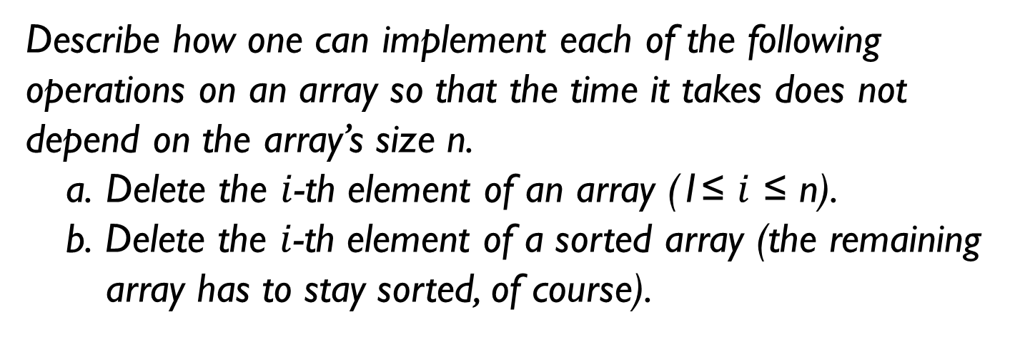
Q1
Describe how one can implement each of the following operations on an array so that the time it takes does not depend on the array’s size n.
Delete the $i$-th element of an array (1≤ $i$ ≤ n).
b. Delete the $i$-th element of a sorted array (the remaining array has to stay sorted, of course).

Slide 38
Queue
Queue:
Enqueue Dequeue
Basic operations with lists: Search, Insert, Delete
Compare Arrays and Lists
Special consideration of Priority Queue
Using HEAP structure (Later)

Slide 39
Q2
a. Show the stack after each operation of the following sequence that starts with the empty stack:
push(a), push(b), pop, push(c), push(d), pop
b. Show the queue after each operation of the following sequence that starts with the empty queue:
enqueue(a), enqueue(b), dequeue, enqueue(c), enqueue(d), dequeue

Slide 40
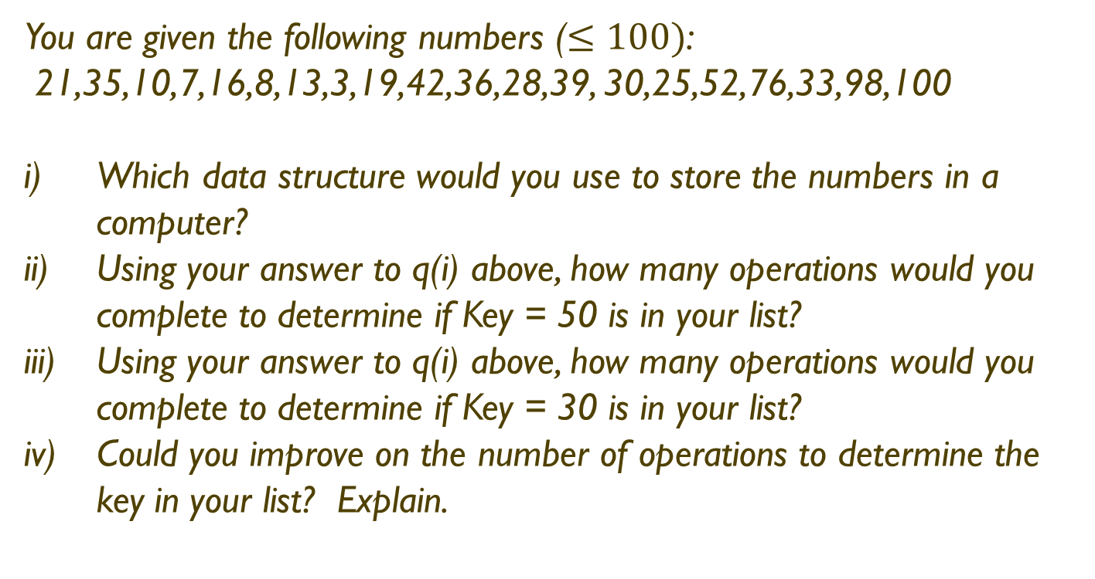
Q3
You are given the following numbers ($≤100)$:
21,35,10,7,16,8,13,3,19,42,36,28,39, 30,25,52,76,33,98,100
Which data structure would you use to store the numbers in a computer?
Using your answer to q(i) above, how many operations would you complete to determine if Key = 50 is in your list?
Using your answer to q(i) above, how many operations would you complete to determine if Key = 30 is in your list?
Could you improve on the number of operations to determine the key in your list? Explain.

Slide 41
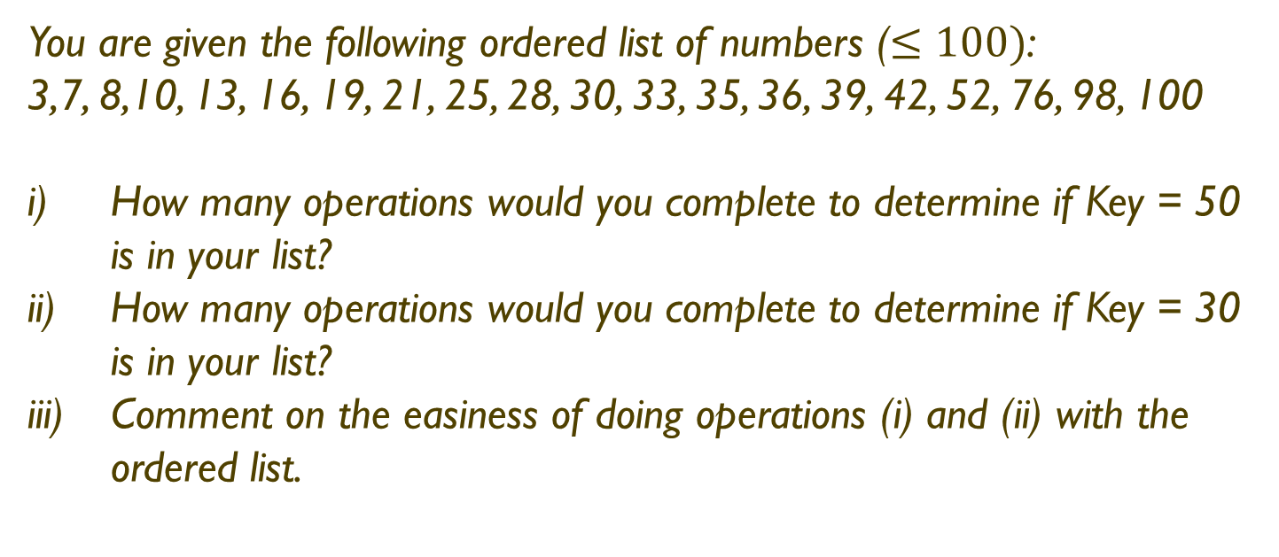
Q3
You are given the following ordered list of numbers ($≤100)$:
3,7, 8,10, 13, 16, 19, 21, 25, 28, 30, 33, 35, 36, 39, 42, 52, 76, 98, 100
How many operations would you complete to determine if Key = 50 is in your list?
How many operations would you complete to determine if Key = 30 is in your list?
Comment on the easiness of doing operations (i) and (ii) with the ordered list.

Slide 42
Character Strings as Arrays
Our task is to store non-numeric text data, i.e. a sequence of characters which are called strings.
A string is an list (or string) of characters stored contiguously with a marker to indicate the end of the string.
Let us consider the task:
STRING0: Read and store a string of characters and print it out.
Since the characters of a string are stored contiguously, we can easily implement a string by using an array of characters if we keep track of the number of elements stored in the array.
However, common operations on strings include breaking them up into parts (called substrings), joining them together to create new strings, replacing parts of them with other strings, etc. There must be some way of detecting the size of a current valid string stored in an array of characters.
A string of characters is stored in successive elements of a character array and terminated by the NULL character to detect the end.

Slide 43
Character Strings as Arrays
For example, the string "Hello" is stored in a character array, msg[], as follows:
char msg[SIZE];
msg[0] = 'H';
msg[1] = 'e';
msg[2] = 'l';
msg[3] = 'l';
msg[4] = 'o';
msg[5] = '\0’; (NULL character)

Slide 44
String Matching
What is a string?
A string is a sequence of -
alpha-numeric and special characters;
bit strings, which comprise zeros and ones;
gene sequences in DNA.
What is String Matching?
Discovering the occurrence of a given ‘pattern’ with the string.
Examples:
Search character string
TWO ROADS DIVERGED IN A YELLOW WOOD
for key word ROADS

Slide 45
String Matching
The Brute Force algorithm compares the pattern to the text, one character at a time, until unmatching characters are found:
TWO ROADS DIVERGED IN A YELLOW WOOD
ROADS
TWO ROADS DIVERGED IN A YELLOW WOOD
ROADS
TWO ROADS DIVERGED IN A YELLOW WOOD
ROADS
TWO ROADS DIVERGED IN A YELLOW WOOD
ROADS
TWO ROADS DIVERGED IN A YELLOW WOOD
ROADS
- Compared characters are italicized.
- Correct matches are in boldface type.

Slide 46
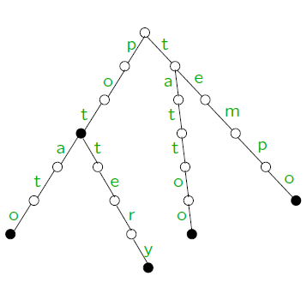

Graph Problems
What is a graph?
Graph can be thought of as a collection of points called vertices, some of which are connected by line segments called edges.
Examples:

Slide 47

Graph Problems
Graph Terminology
G= (V,E) V – Vertices E – Edges
V = {a,b,c,d,e,f}
E = {(a,c),(a,d),(b,c),(b,f),(c,e),(d,e),(e,f)}
V = {a,b,c,d,e,f}
E = {(a,c),(d,a),(b,c),(b,f),(c,e),(d,e),(e,c),(e,f)}
Loop
Cycles (Acyclic)
Dense
Sparse

Slide 48
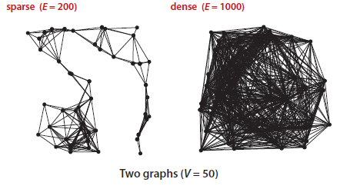
Sparse and Dense Graphs

Slide 49
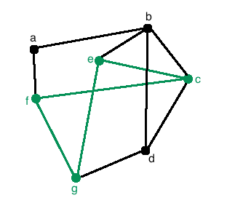
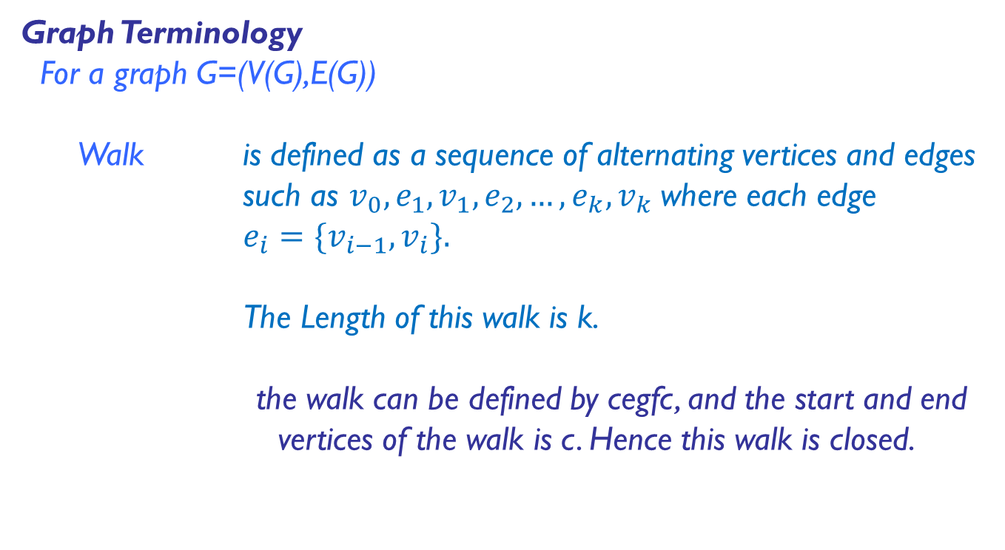
Graph Problems
Graph Terminology
For a graph G=(V(G),E(G))
Walk is defined as a sequence of alternating vertices and edges such as $v_{0},e_{1},v_{1},e_{2},…,e_{k},v_{k}$where each edge
$e_{i}=\{v_{i−1},v_{i}\}.$
The Length of this walk is k.
the walk can be defined by cegfc, and the start and end vertices of the walk is c. Hence this walk is closed.

Slide 50
Graph Problems
Graph Terminology
For a graph G=(V(G),E(G))
Trail is defined as a walk with no repeated edges.
Circuit is a closed trail. That is, a circuit has no repeated edges but may have repeated vertices.
Path is a trail in which all vertices are distinct.
Connected A path exists between every pair of vertex.

Slide 51
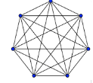
Graph Problems
Graph Terminology
For a graph G=(V(G),E(G))
Cycle is defined as a closed trail where no other vertices are repeated apart from the start/end vertex.
Loop is defined as a closed trail from node to itself in one step.
Complete Graph Simple undirected graph in
which every pair of distinct
vertices is connected by a
unique edge

Slide 52
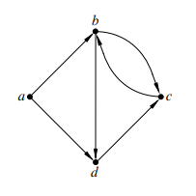
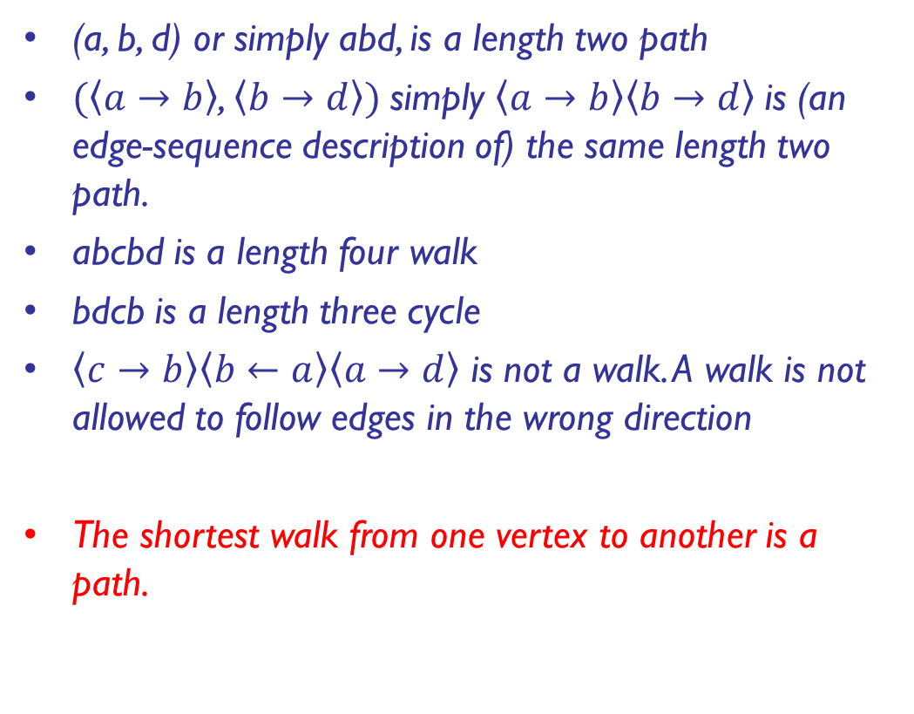
Graph Problems
(a, b, d) or simply abd, is a length two path
$(\left\langle a→b\right\rangle$, $\left\langle b→d\right\rangle )$simply $\left\langle a→b\right\rangle \left\langle b→d\right\rangle$is (an edge-sequence description of) the same length two path.
abcbd is a length four walk
bdcb is a length three cycle
$\left\langle c→b\right\rangle \left\langle b←a\right\rangle \left\langle a→d\right\rangle$ is not a walk. A walk is not allowed to follow edges in the wrong direction
The shortest walk from one vertex to another is a path.

Slide 53
Graphs
We have the following inequality for the number of edges |E|
possible in an undirected graph with |V | vertices and no loops:
Min: (|V| − 1) ≤ |E| ≤ Max:|V|(|V| − 1)/2

Slide 54
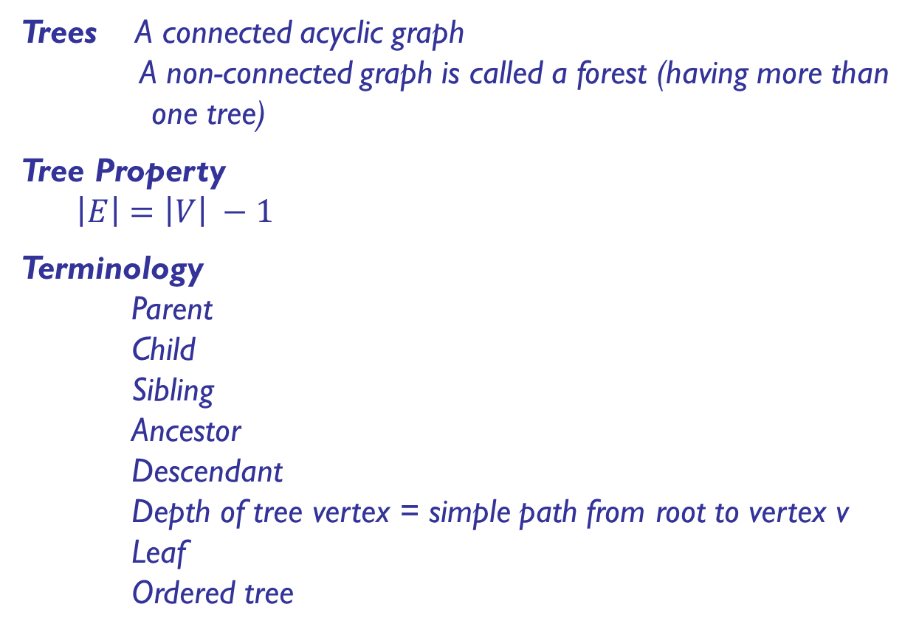
Graph Problems
Trees A connected acyclic graph
A non-connected graph is called a forest (having more than one tree)
Tree Property
$\left|E\right|=\left|V\right| −1$
Terminology
Parent
Child
Sibling
Ancestor
Descendant
Depth of tree vertex = simple path from root to vertex v
Leaf
Ordered tree

Slide 55
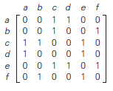
Representing Graphs
Three data structures that immediately suggest themselves for representing graphs:
An adjacency matrix, where we maintain a V-by-V boolean array, with the entry in row v and column w defined to be true if there is an edge adjacent to both vertex v and vertex w in the graph, and to be false otherwise.
This representation fails on the first count—graphs with millions of vertices are common and the space cost for the V² boolean values needed is prohibitive.

Slide 56
Representing Graphs
Three data structures that immediately suggest themselves for representing graphs:
An array of edges, using an Edge class with two instance variables of type int.
This direct representation is simple, but it fails on the second count—implementing adj() would involve examining all the edges in the graph.

Slide 57
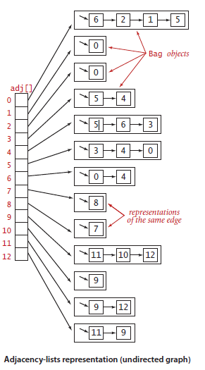
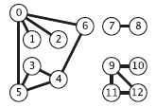
Representing Graphs
Three data structures that immediately suggest themselves for representing graphs:
An array of adjacency lists, where we maintain a vertex-indexed array of lists of the vertices adjacent to each vertex.
This data structure satisfies both requirements for typical applications and is the one that we will use throughout our discussions.

Slide 58
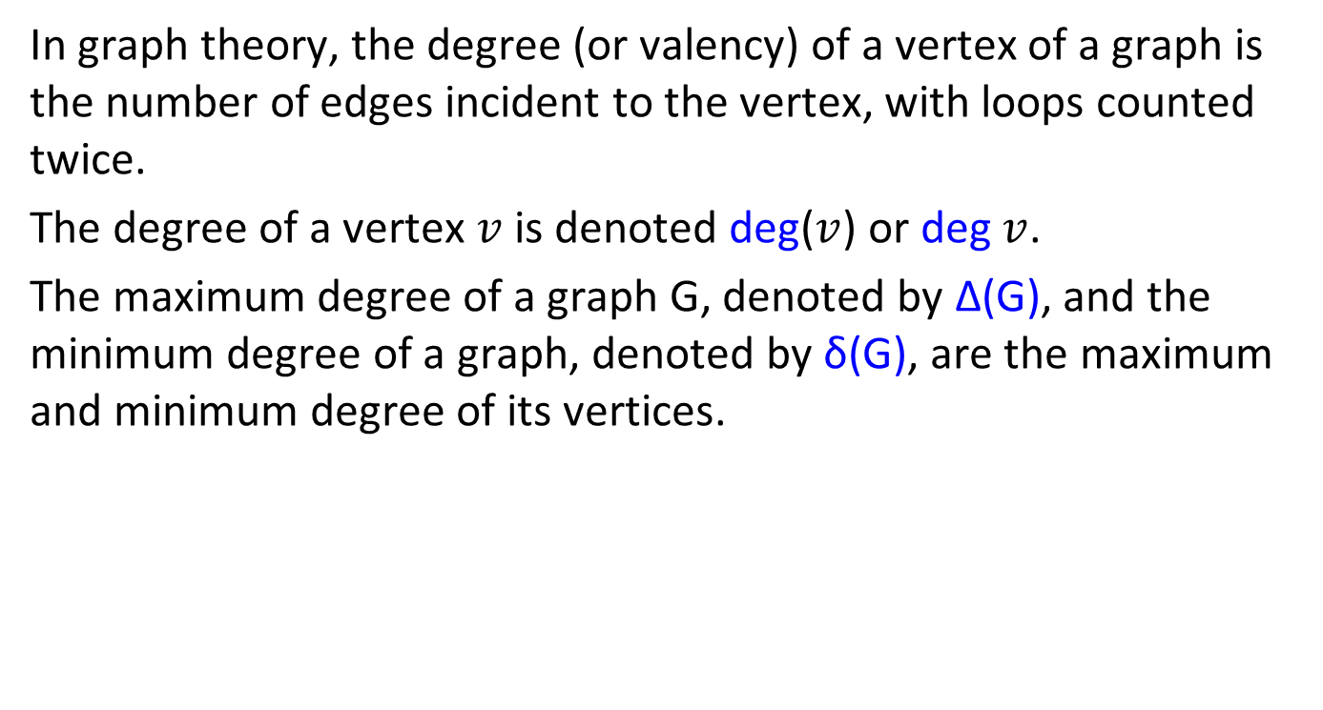
Degree or Valency of a Vertex
In graph theory, the degree (or valency) of a vertex of a graph is the number of edges incident to the vertex, with loops counted twice.
The degree of a vertex $v$ is denoted deg($v$) or deg $v$.
The maximum degree of a graph G, denoted by Δ(G), and the minimum degree of a graph, denoted by δ(G), are the maximum and minimum degree of its vertices.

Slide 59
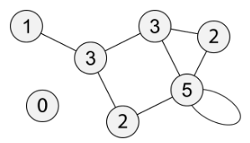
Degree or Valency of a Vertex
In the following graph, the maximum degree is 5 and the minimum degree is 0.
Directed Graph: In-Degree, Out-Degree

Slide 60
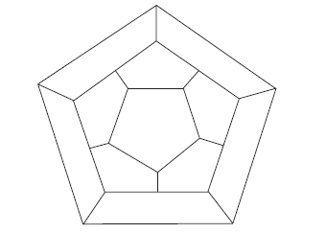
Example
Icosian Game - This one invented by the renowned Irish mathematician Sir William Hamilton (1805–1865)—was presented to the world under the name of the Icosian Game.
Let us convert the game board to a graph.

Slide 61
Example
Icosian Game - This one invented by the renowned Irish mathematician Sir William Hamilton (1805–1865)—was presented to the world under the name of the Icosian Game.
Let us convert the game board to a graph.
a
f
b
j
g
k
e
c
i
h
d

Slide 62
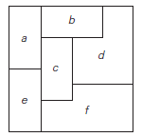
Example
Consider the following map:
Represent the map as a graph.
Color the vertices using the following rule: no two adjacent vertices are colored the same.
What is the smallest number of colors needed in part (b)?

Slide 63
Partitioning Graph
In graph theory, a part of mathematics, a k-partite graph is a graph whose vertices are or can be partitioned into k different independent sets.
Equivalently, it is a graph that can be colored with k colors, so that no two endpoints of an edge have the same color.
When k = 2 these are the bipartite graphs, and when k = 3 they are called the tripartite graphs.

Slide 64
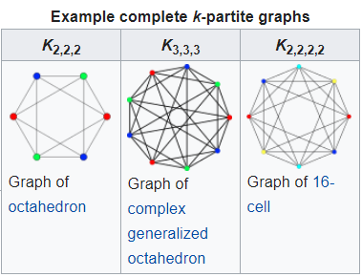
Partitioning Graph
When k = 2 these are the bipartite graphs, and when k = 3 they are called the tripartite graphs.

Slide 65
Graphs
Sets
- Collection of unordered distinct elements (use of Multiset concept)
Multiset: In mathematics, a multiset (aka bag or mset) is a modification of the concept of a set that, unlike a set, allows for multiple instances for each of its elements. The positive integer number of instances, given for each element is called the multiplicity of this element in the multiset.
- Universal set

Slide 66
Graphs
Dictionary: A data structure that implements the three operations SEARCH: searching for a given item,
ADD: adding a new item, and
DELETE: deleting an item
from the collection is called the dictionary.
Problems involving operations with sets:
- Applications in computing which require a dynamic partition of some n-element set into a collection of disjoint subsets.

Slide 67
Summary
In Summary:
The non-ambiguity requirement for each step of an algorithm cannot be compromised;
The range of inputs for which an algorithm works has to be speciﬁed carefully;
There may exist several algorithms for solving the same problem;
The same algorithm can be implemented in several different ways.

Slide 68
Questions ?!

Slide 69
Example
You have bag of five unique colors. How many color arrangements can be created in this instance? Name the colors as “B”,”G”,”Y”,”R”,”V” for your question.

Slide 70
Example
A bag contains 15 numbered marbles of which 10 are red and 5 are white. 4 marbles are selected from the bag.
Q1. How many (different) samples (of size 4) are possible?
Q2. How many samples (of size 4) consist entirely of red marbles?
Q3. How many samples have 2 red and 2 white marbles?
Q4. How many samples (of size 4) have exactly 3 red marbles?
Q5. How many samples (of size 4) have at least 3 red?

Slide 71
Example
How many poker hands consist of 2 Aces, 2 Kings and a
card of a different denomination?

Slide 72

Example
How many different words (including nonsense words) can you make by rearranging the letters of the word ABET?
ABET | BAET | EBAT | TBEA
ABTE | BATE | EBTA | TBAE
AEBT | BEAT | EABT | TEBA
AETB | BETA | EATB | TEAB
ATBE | BTAE | ETBA | TABE
ATEB | BTEA | ETAB | TAEB
$$4_{P_{4}}$$

Slide 73
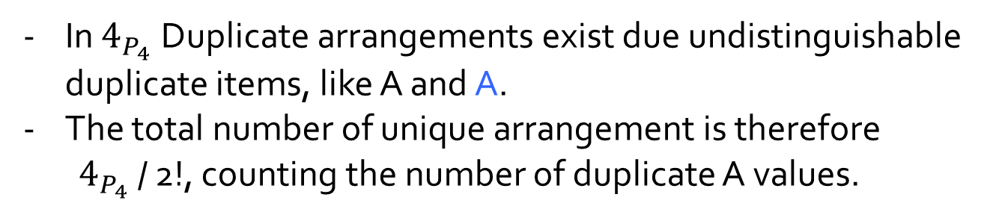
Example
ABAT | BAAT | ABAT | TBAA
ABTA | BATA | ABTA | TBAA
AABT | BAAT | AABT | TABA
AATB | BATA | AATB | TAAB
ATBA | BTAA | ATBA | TABA
ATAB | BTAA | ATAB | TAAB
In $4_{P_{4}}$Duplicate arrangements exist due undistinguishable duplicate items, like A and A.
The total number of unique arrangement is therefore
$4_{P_{4}}$ / 2!, counting the number of duplicate A values.

Slide 74

Example
The number of duplicate arrangements due to the 2 indistinguishable A’s are = 2! = 2
ABAT | BAAT | ABAT | TBAA
ABTA | BATA | ABTA | TBAA
AABT | BAAT | AABT | TABA
AATB | BATA | AATB | TAAB
ATBA | BTAA | ATBA | TABA
ATAB | BTAA | ATAB | TAAB
$∴$ Unique arrangements$=\frac{4_{P_{4}}}{2!}$ = 12

Slide 75
Example
(a) How many different words (including nonsense words) can you make by rearranging the letters of the word?
EFFERVESCENCE

Slide 76
Example
How can we create a simple 5 x 7 matrix, like the ones in the diagram
1 | 2 | 3 | 4 | 5
2 | 4 | 6 | 8 | 10
3 | 6 | 9 | 12 | 15
4 | 8 | 12 | 16 | 20
5 | 10 | 15 | 20 | 25
6 | 12 | 18 | 24 | 30
7 | 14 | 21 | 28 | 35
3 5 7 9
9 15 21 27
15 25 35 45
21 35 49 63
27 45 63 81
33 55 77 99
13 39 65 91 117

Slide 77
Example
Given an M x N matrix in which each row and each column is sorted in ascending order, write a method to find a key.

Slide 78
END

